Slide 1


Class 9
Completing an audit
This FOUNDATION Class has been created by

Slide 2
Auditing
This tutorial explains what an audit looks like and what the process is to complete one

Slide 3

What is an audit?
An independent verification of your usage reports, based on the COUNTER Code of Practice

Slide 4
Getting ready for an audit
Register with COUNTER
Choose your auditor
Familiarise yourself with the Code
Review your Usage Reports

Slide 5
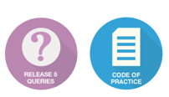



Become a member of
COUNTER
Agree which COUNTER Reports are relevant to you.
Contact: Lorraine Estelle,
COUNTER Director at:
lorraine.estelle@counterusage.org

Slide 6

Choose your auditor
There’s a choice of auditors, see: www.projectcounter.org

Slide 7
Familiarise yourself with the Code of Practice

Slide 8

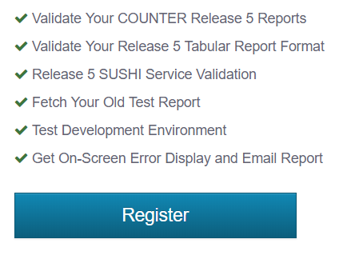

Review your Usage Reports
Register to use COUNTER’s
Validation Tool

Slide 9

What does the audit process look like?
Notes:
So, now you know how to prepare for an audit, let’s take a look at what a typical COUNTER audit looks like…

Slide 10
3 stages to your audit
Stage 1 - Set up
Stage 2 - Testing
Stage 3 - Checking
Notes:
A COUNTER audit follows a 3 stage process. Here’s what you can expect in each…

Slide 11
Stage 1 - set up
Initial investigations
Metrics and reports
Log-ins and access rights

Slide 12

Stage 2 - testing
Activity is made by your auditor
Notes:
In stage 2 your auditor will create activity on your site, as if they are an institutional user. This will populate your usage reports for them.

Slide 13

Stage 3 - checking
Activity made by your auditor is compared to your Usage Reports

Slide 14

If no issues, you’ve passed!
Stage 3 - checking
Notes:
If all has gone well and no issues arise, you’ll receive a report from your auditor confirming successful completion.
This report is shared with COUNTER, so they can update the Registry on the COUNTER website.

Slide 15

If there are issues, you have up to 3 months to resolve them
Stage 3 - checking
Notes:
If any issues of non-compliance are found, your auditor will advise you and COUNTER of these and work with you to correct them. The Code allows up to 3 months for corrections to be made.
Once you believe all the issues are resolved, your auditor will re-run the usage reports. They’ll check them against the activity originally made in order to confirm their compliance.
Upon successful completion you’ll receive a report from your auditor confirming this which is shared with COUNTER, so they can update the Registry on the COUNTER website.

Slide 16

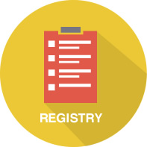
How to promote your COUNTER Compliance
The COUNTER Date Stamped Logo
The COUNTER Registry of Compliance

Slide 17

How long does it take?

Slide 18
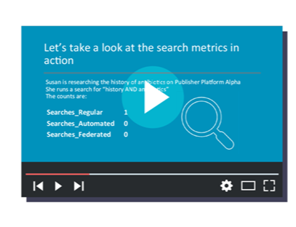
Learn more
Visit our COUNTER YouTube Channel where you will find more Foundation Classes

